Slide 1
Chapter 1
What is an Athletic Trainer

Slide 2
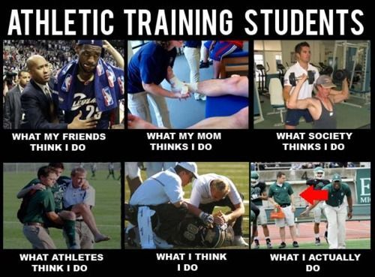
What is Athletic Training

Slide 3
What is an Athletic Trainer
According to your text book Athletic Trainers are part of an American Medical Association (AMA) recognized allied health.
Preventive medicine, emergency care, injury assessment, treatment protocols, therapeutic exercise, psychological impacts of injury, and return to play criteria

Slide 4
Brief History of Athletic Training
First Athletic Training Text book was called The Trainer’s Bible 1917
The Cramer company started making liniment to treat ankle sprains in the 1920s.
Cramer found that there was a market for treating athletic injuries
Cramer then began publication of the First Aider in 1932
The Field of Athletic Training has continued to grow and prosper!!!

Slide 5
A brief History continued…
During the Late 1930s the National Athletic Trainers’ Association (NATA) was formed
But during WWII the group disappeared
Between 1947 and 1950 the group once again organized.
NATA 1950- Present

Slide 6
NATA
The NATA mission statement
“To enhance the quality of health care provided by certified athletic trainers and to advance the athletic training profession.”
Every year there is a Convention where athletic trainers from all over the United States meet, and get continuing education credits, and learn new things.

Slide 7
Board of Certification Domains
The Board of Certification or (BOC)
Defined 6 Domains Certified Athletic Trainers should have knowledge and skills in
Prevention
Clinical Evaluation and Diagnosis
Immediate Care
Treatment, Rehabilitation, and Reconditioning
Organization and administration
Professional responsibilities

Slide 8
Committee for Accreditation of Athletic Training
CAATE- Made it possible for institutions across the United states to offer entry-level bachelors programs.
Nebraska Colleges that are CAATE accredited
University of Nebraska at Kearney
University of Nebraska Lincoln
University of Nebraska at Omaha
Nebraska Wesleyan University (Its in Lincoln)

Slide 9
Where can an Athletic Trainer Work?
Industrial/ Occupational Settings
Work Places like factories
Corporate Settings
Sales, or marketing products

Slide 10
Where Can an Athletic Trainer Work?
Colleges or Universities
UNL, UNK, UNO, ISU, COU….
Secondary Schools
Lexington, Hastings, Kearney, Grand Island….
Professional Sports
NFL, NBA, MLB, NHL, WNBA…
Amateur/Recreational/Youth Sports
Olympics, Amateur Athletic Union (AAU)

Slide 11
Where Can Athletic Trainers Work? Continued…
Performing Arts
Disney, Large Casinos…
Military/Law Enforcement/Government
Navy, Marines, Army…
Health and Fitness Clubs
Treating Physically Active Populations
Adolescent Athletes
The Aging Athlete
The Occupational Athlete

Slide 12
Who Else is Involved in the Sports Medicine Team
Orthopedic Surgeons
Physicians
Dentists
Podiatrists
Nurses
Physician Assistants
Physical Therapists
Occupational Therapists
Athletic Trainers
Exercise Physiologists
Biomechanist
Study movement
Nutritionists
Sport Psychologists
Coaches
Strength and Conditioning Specialists
Social Workers
Chiropractors

Slide 13
Salary June of 2005.
Amateur Sports- $41,045
College/University-Faculty/Academic/Research- $51,647
Government- $50,716
Hospital-Emergency Department- $57,000
Military- Active Duty- $46,000
Military- Civilian- $49,000
Pro Basketball MEN- $32,827
Pro Football- $80,111
Secondary School- High School (Public)- $43,884
Youth Sports- $46,296

Slide 14
Appearance
Business Casual
Khaki Pants or Shorts
Polo Shirt
Coat and Tie or a Suit or business attire for women
Students Attire
Khaki Pants or Shorts
ATS Tee shirt or Lexington Polo
NO Flat Billed Caps!
NO Short shorts!
NO Yoga Pants!
No holes in Pants
You will be sent home to change if you violate MY dress code.

Slide 15
Behavior
Professional- Remember your friends are playing a game NO conversations.
Be early- My philosophy is 5 minutes early is 10 minutes late. So when I say 7:00p.m I really mean 6:45 p.m.
Don’t be afraid to get involved!
Ask questions if you have any! I enjoy answering questions so ask as many as you want!
Listen to my interns or else!

